Slide 1

Twitter Sentimental Analysis
USING CLASSIFICATION

Slide 2
Our team
Bansil Patel
Harsh Mohile
Rachit Bhatt
Akshiths Ralla
Sakshi

Slide 3
Contents
Introduction Objective Quick Scan of dataset Data Pre-processing EDA (Exploratory Data Analysis) Natural language processing and its various methods Machine Learning Classification Data Visualisation Real time Analysis Utilisation of the Project Conclusion

Slide 4
Introduction
In today’s networked world, social media Interfaces have become an inseparable aspect of our lives. Twitter, a compact communication platform, is a treasure trove of diverse user sentiments expressed in short and concise messages. Utilizing the power of natural language processing and machine learning, the project desires to perform sentiment analysis on Twitter data through a classification approach.

Slide 5
Objective of the project
The fundamental aim of our project is to develop a robust sentiment analysis system that classifies tweets into different sentiment categories such as positive, negative, or neutral. By simplifying sentiment analysis, we can gain in-depth understandings into the public's reactions to various events, products, or topics.

Slide 6
Quick Scan of the Dataset
We will utilize a dataset comprised of tweets collected from Twitter's API. The dataset will be pre-processed to remove noise, handle missing data, and standardize text for effective analysis. Each tweet in the dataset will be labeled with its corresponding sentiment, forming the basis for our supervised machine learning model.

Slide 7
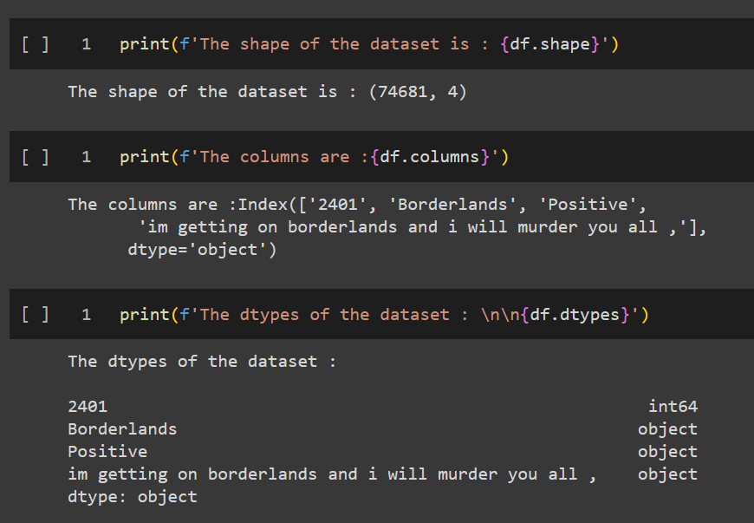
Quick Scan of the Dataset
We are checking how our dataset, structure, and the data structure of the fields.

Slide 8
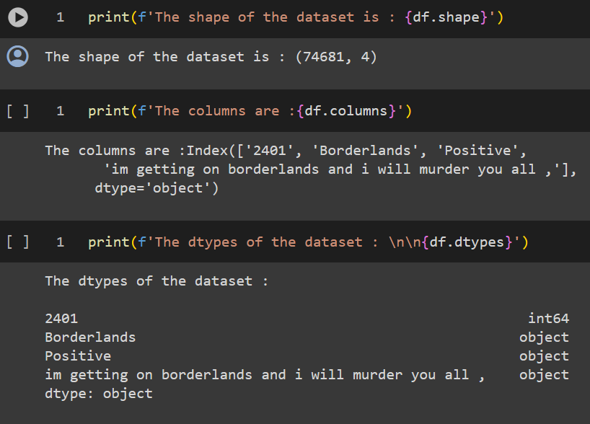
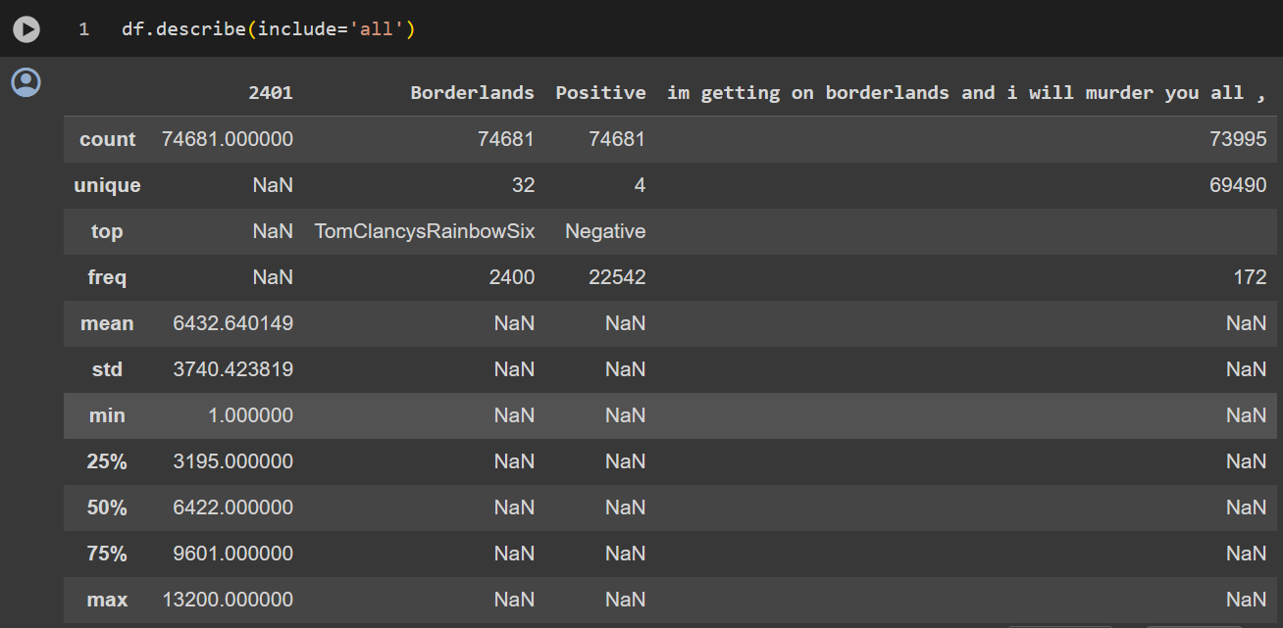
Data Pre-processing

Slide 9
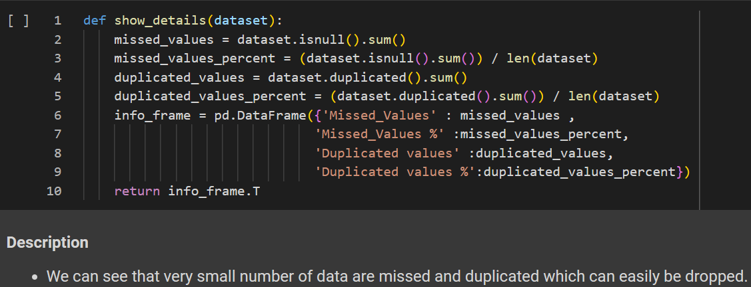
EDA (Exploratory Analysis)
It is used to analyze and visualize data sets to summarize their main characteristics, often with the help of statistical graphics and other data visualization methods.

Slide 10
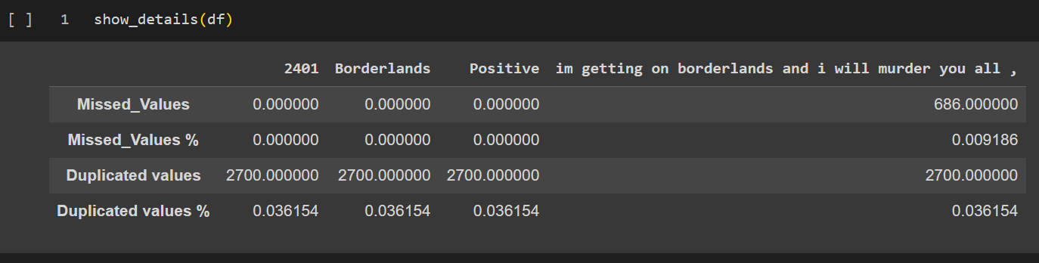
EDA Cont.
Finding the missing and duplicated values in the dataset.

Slide 11
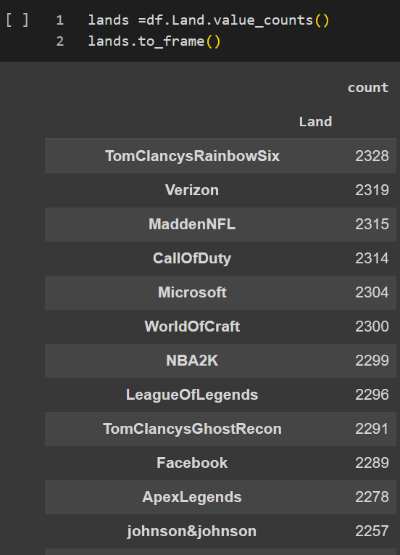
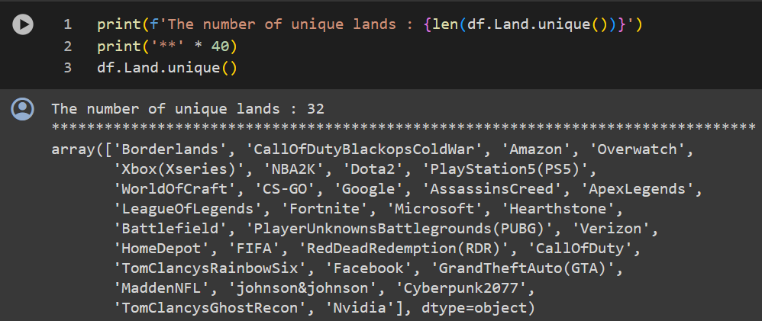
EDA Cont.
Checking the unique values of each feature.

Slide 12
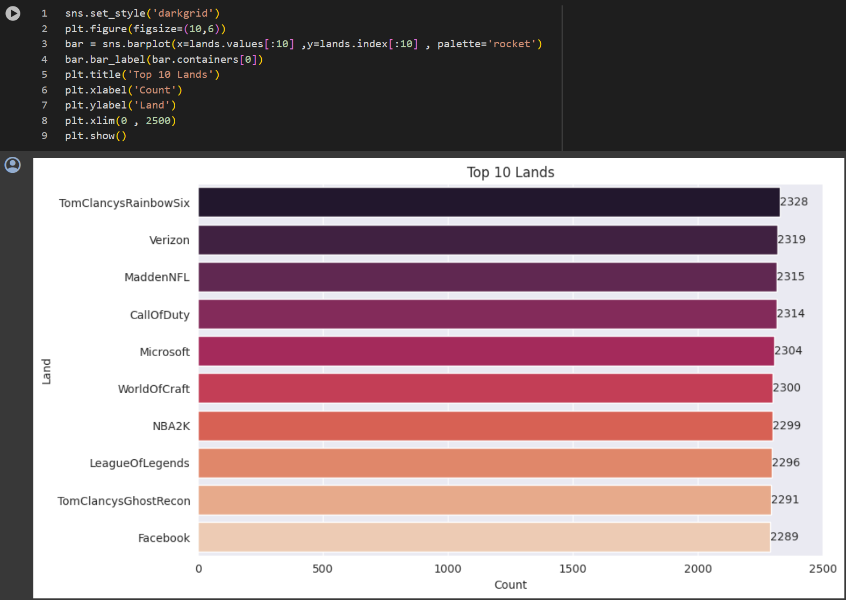
EDA Cont.
Top 10 trending hashtag (#) on twitter.
TomClancysRainbowSix
CallOfDuty
LeagueOfLegends

Slide 13
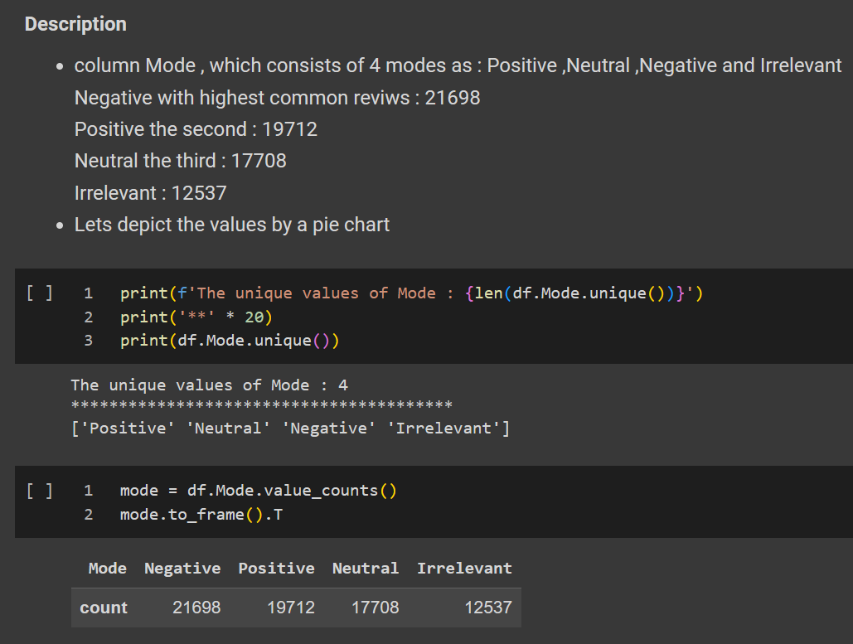
EDA Cont.
Finding value-count after renaming columns.
Checking its unique values.
Validating duplicate values.

Slide 14
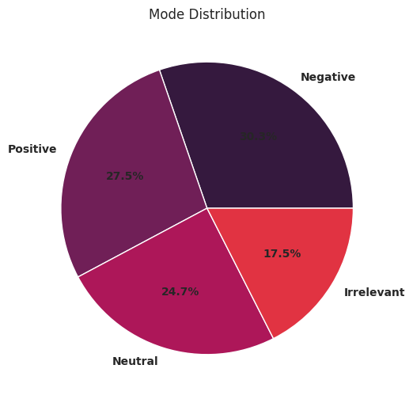
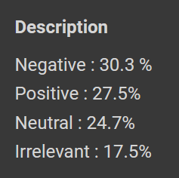
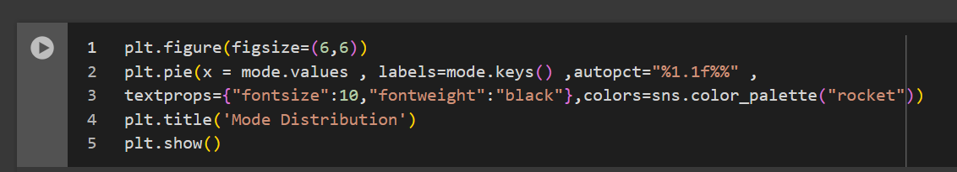
EDA Cont.
Most of words used in tweets.

Slide 15
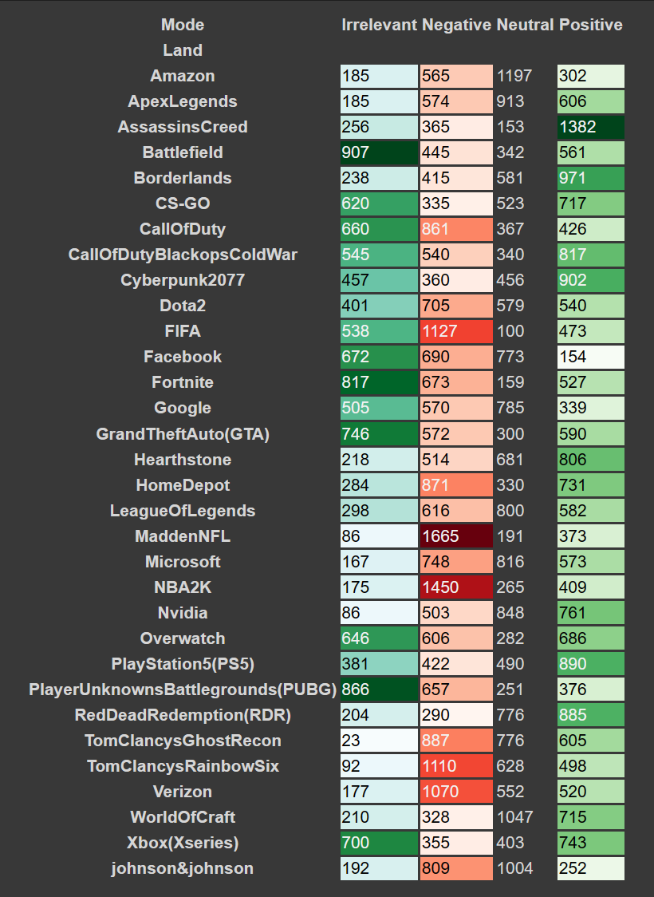
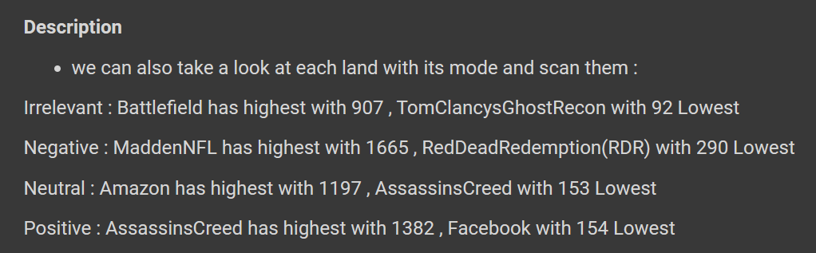
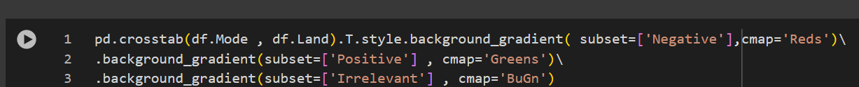
EDA Cont.
Various tweets having amount of irrelevance/negation/neutral/positiveness.

Slide 16
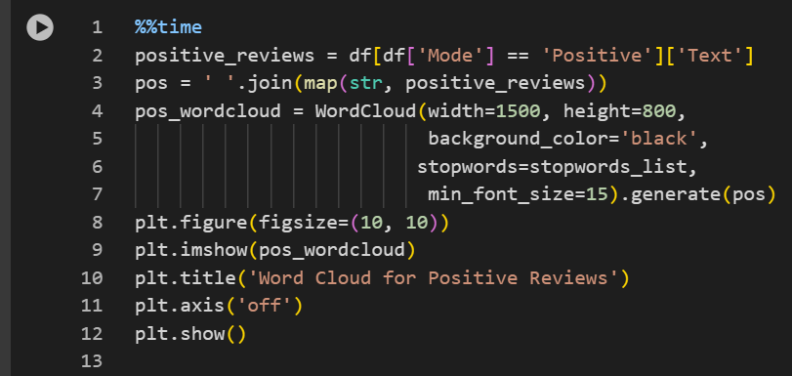
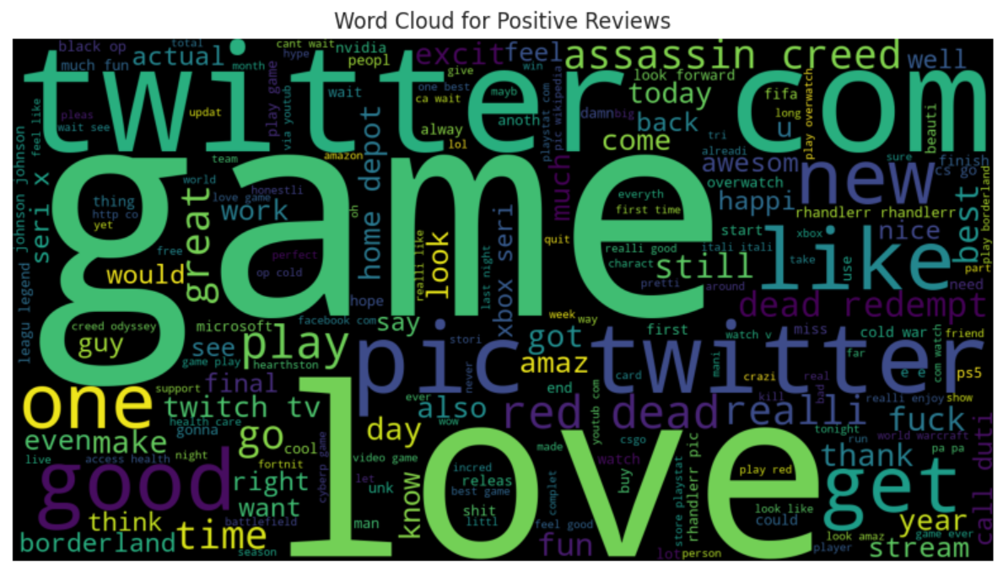
EDA Cont.
Various positive words used in the tweets describing mood in the tweet.

Slide 17
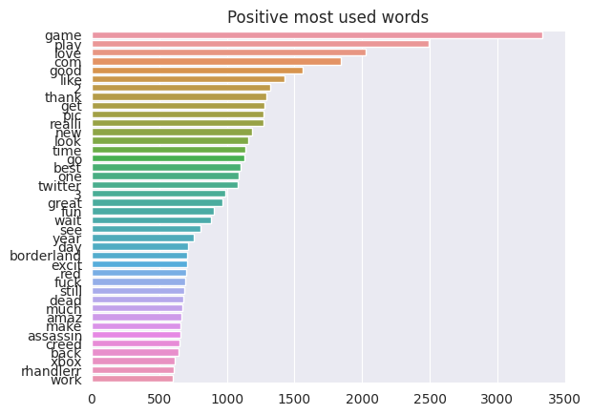
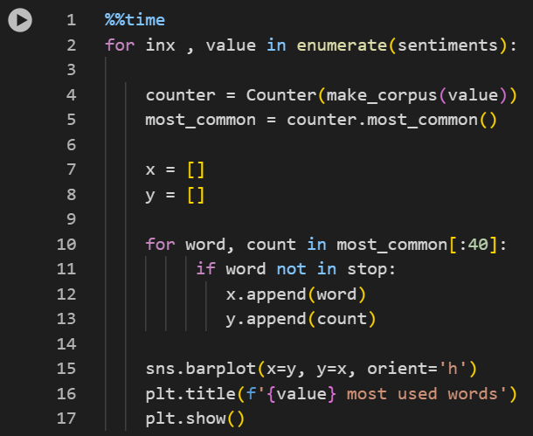
EDA Cont.
Describing various words for positive sentiments.

Slide 18
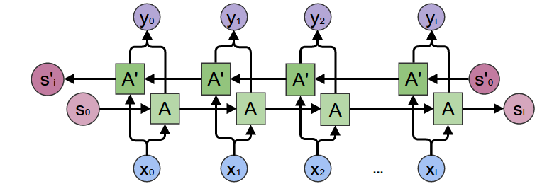
Machine Learning Classification
In summary, BiLSTM adds one more LSTM layer, which reverses the direction of information flow. Briefly, it means that the input sequence flows backward in the additional LSTM layer. Then we combine the outputs from both LSTM layers in several ways, such as average, sum, multiplication, or concatenation.

Slide 19
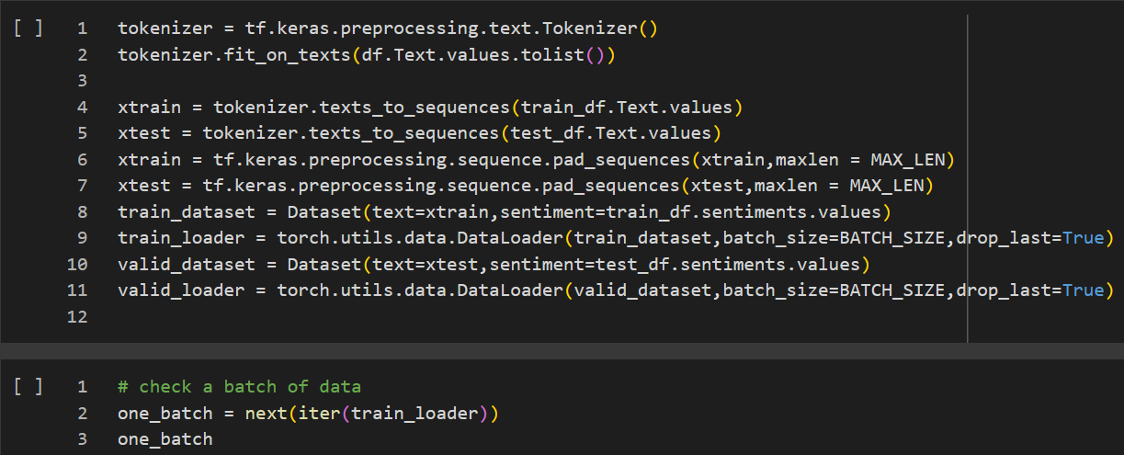
Machine Learning Classification Cont.

Slide 20
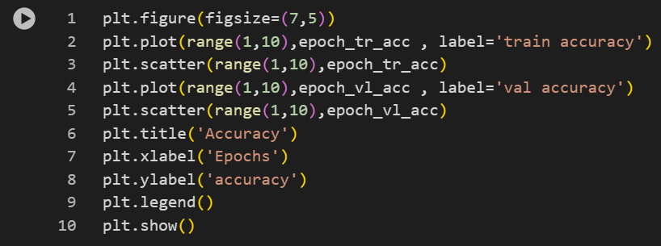
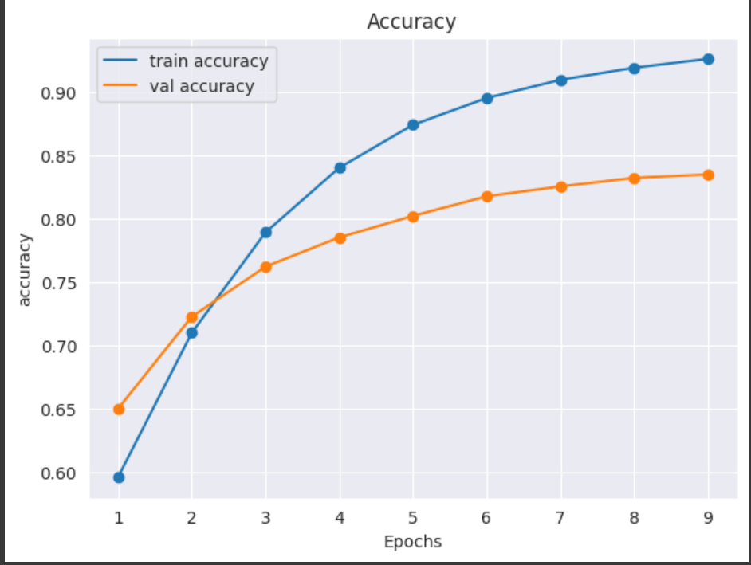
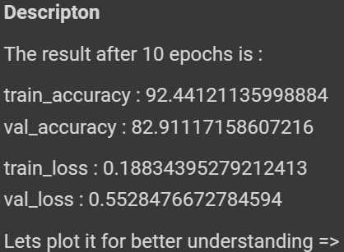
Data Visualization
Provides a clear understanding of the most frequent words associated with each sentiment class and the model's performance metrics.

Slide 21

Utilisation of the Project
///////////
///////////
With the help of sentiment analysis any of the organization could easily found the honest review of their product.
Organization could easily understand that their client are happy or not from the product.
We use the twitter data and the reason behind it nowadays people are posting any thing on the twitter to show whether they are happy or not from the product or from any on the organization.

Slide 22
Challenges and Considerations
Challenges such as handling sarcasm, context-dependent sentiments, and potential biases in the training data will be addressed to enhance the robustness and fairness of our sentiment analysis system.

Slide 23

Conclusion
We are getting the mood of the person when they are posting something on the twitter

Slide 24
References
Kaggle
Google
Stack Overflow

Slide 25
Thanks!
Do you have any questions ?

